Slide 1

Embedded Systems and Internet of Things (ES&IOT) Lab
Robo for IOT –Based Irrigation System
Parth Chandel , 2310991090.
Parth Thakur,2310991091.
Prashant Sainbhi, 2310991098.
Sania Khanijo,2310991122.
Satvik Lakhanpal, 2310991126.
Class Group: G6
Project Guide Name (ES&IOT Faculty Name):
Dr. Manish Singla
Designation: Assisstant Professor
Department of Interdisciplinary Courses in Engineering

Slide 2
Introduction
In the modern era, agriculture faces numerous challenges, including water scarcity, inefficient resource management, and the need for sustainable practices. Traditional irrigation methods often fall short in addressing these issues, leading to overuse or underuse of water resources. To tackle these challenges, we introduce the Robo-Based IoT Irrigation System—a groundbreaking solution designed to revolutionize how we manage agricultural irrigation .Our system leverages the power of the Internet of Things (IoT) combined with advanced robotics to provide a smart, efficient, and automated approach to irrigation. At its core, this system integrates sensors, data analytics, and robotic automation to optimize water usage, reduce waste.

Slide 3
Problem Statement
Current Situation:
Traditional irrigation systems often rely on manual timers or fixed schedules, which can lead to:
Water waste: Overwatering due to inaccurate estimations of soil moisture needs.
Increased labor costs: Manual monitoring and adjustments require significant time and effort.
Inefficient water management: Inability to adapt to changing weather conditions or specific plant needs.
Problem:
To develop a smart robo for irrigation system using Internet of Things (IoT) technology that addresses the limitations of traditional methods and improves water management efficiency in agriculture.

Slide 4
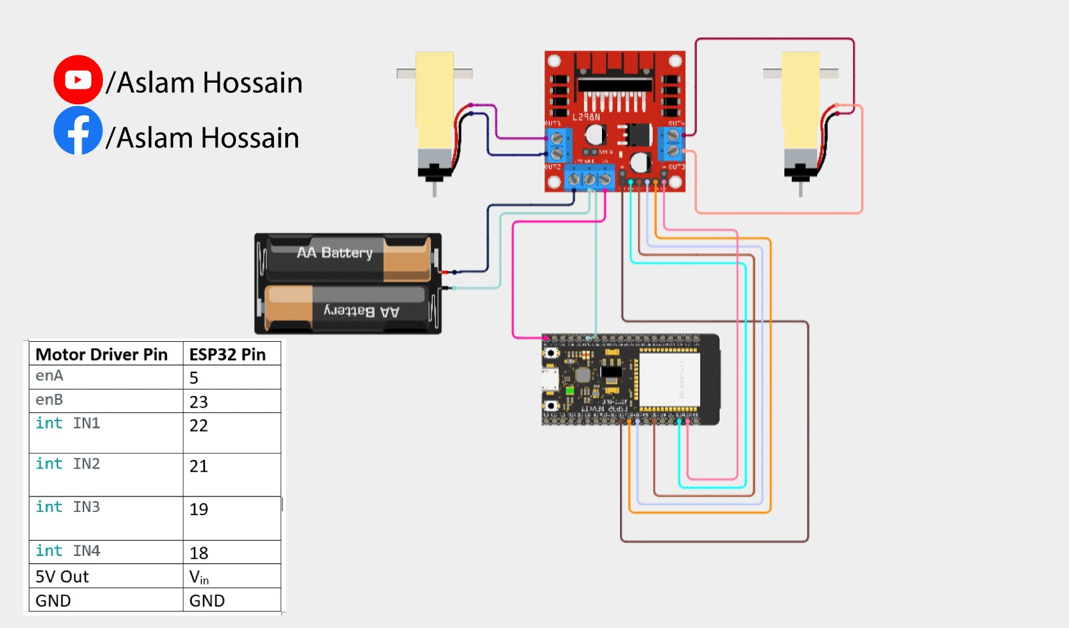
Block Diagram/Circuit Diagram

Slide 6
Project Progress
We have constructed our car with an irrigation system as its foundational component, although it is not yet fully functional. The groundwork we’ve laid is reliable and will support future enhancements. This base is designed to accommodate key components such as sensors and a Bluetooth module, which will be integrated to provide careful irrigation management and soil moisture detection. The system aims to ensure that plants receive the right amount of water based on real-time data from soil moisture sensors. The Bluetooth module will enable remote control and monitoring, allowing for efficient irrigation without manual intervention. While the project is still in its developmental stages, this solid foundation offers a clear path for future advancements. Once the sensors and Bluetooth module are incorporated, the system will provide a smart and sustainable solution for precise irrigation, enhancing the overall efficiency and effectiveness of the system.

Slide 7
Work to be carried out (Pending work)
We have built a car, but it is not yet operational. In the near future, we will focus on making it functional and calculating key factors such as water capacity. We will create a detailed table to determine the precise amount of water required for efficient operation. Additionally, we plan to install a pump for the irrigation system, which will be connected to smartphones, tablets, and other devices via a Bluetooth module for convenient control and management.

Slide 8
Timeline of the Project and Applications
Project Completion Status | (write percentage of the project completed)
30 October 2024 | 50%

Slide 9
Thank you

